Slide 1
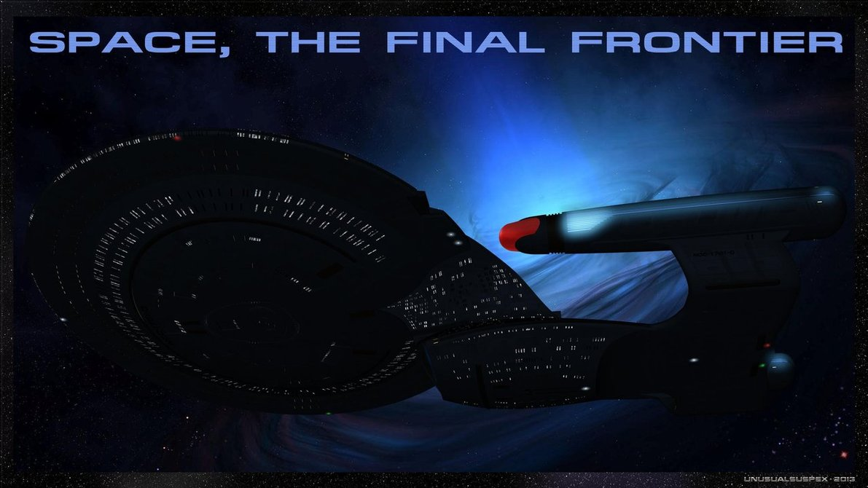

Slide 2
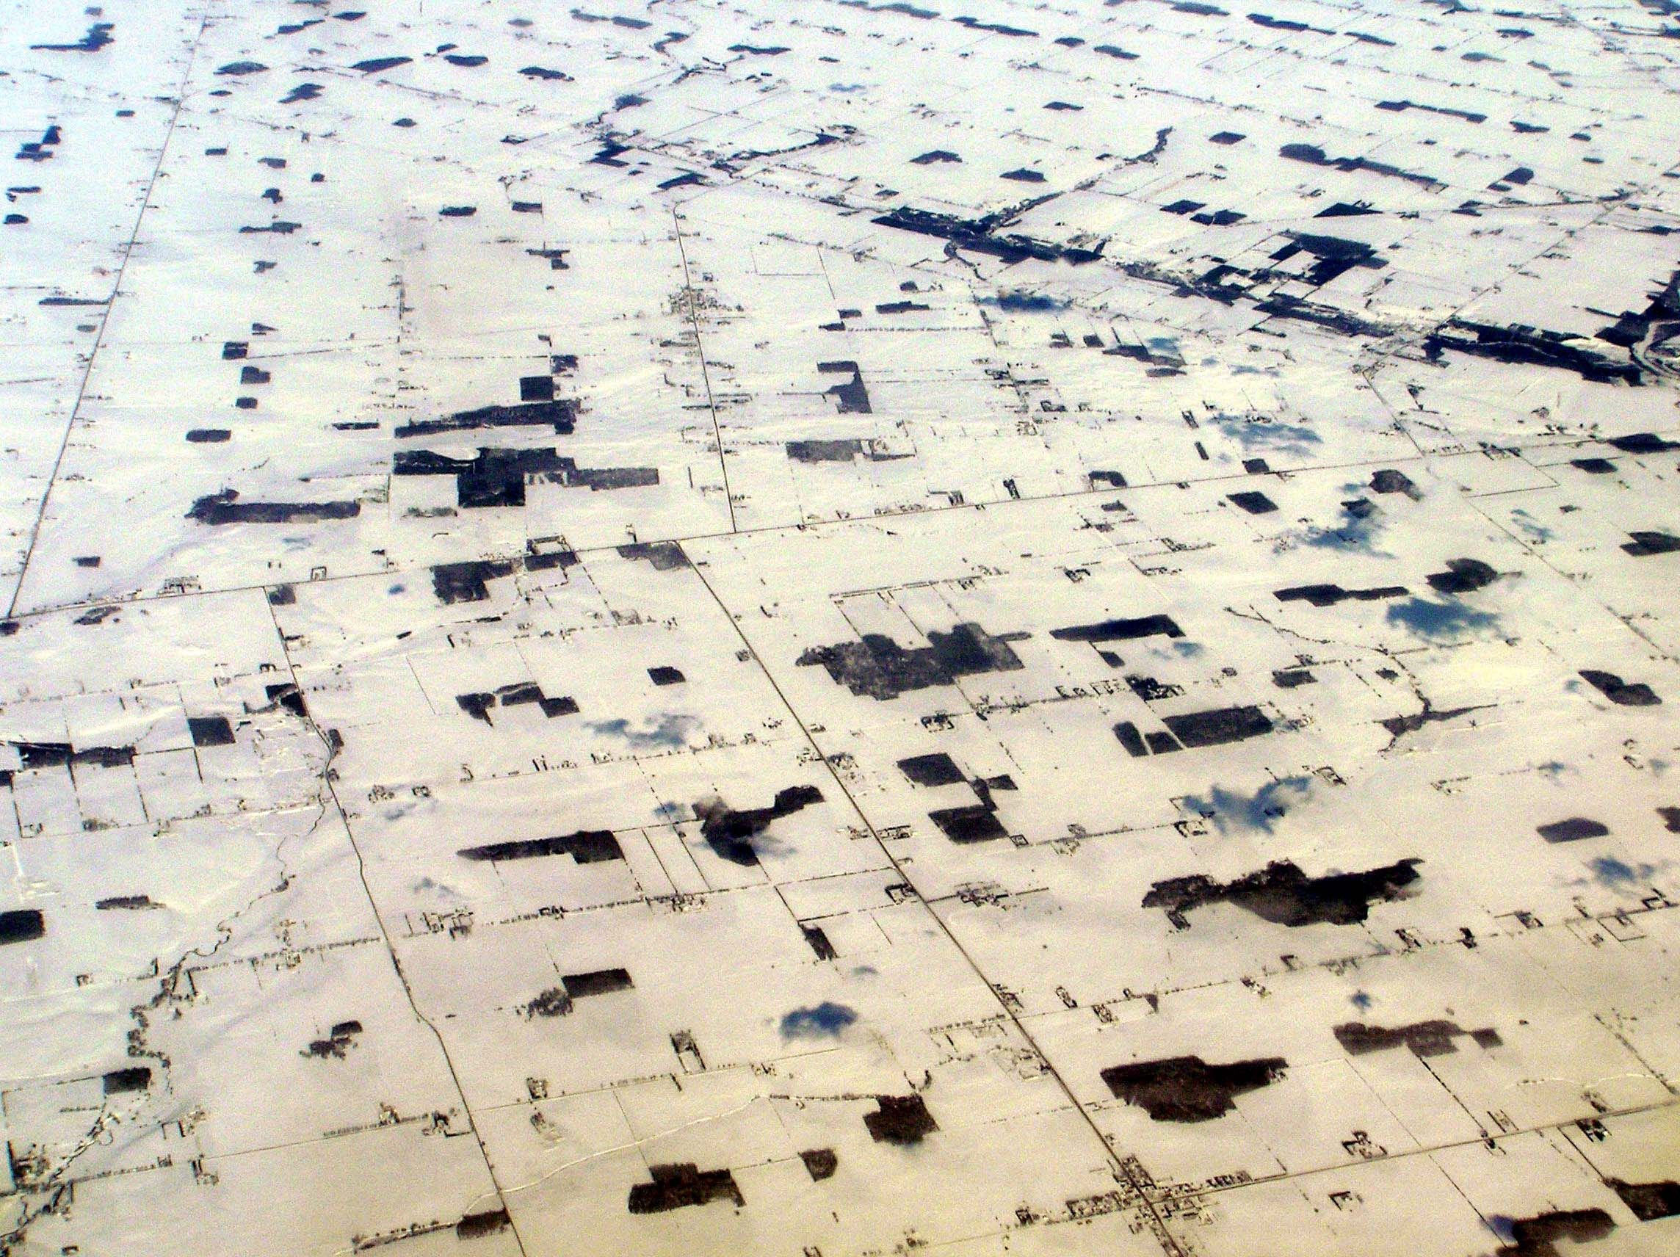
METAPOPULATION
a set of spatially isolated subpopulations of the same species that interact at some level (Levins 1970)
- Small subpopulations within fragments – prone to local extinction
- Connected by dispersal: recolonization of empty patches from occupied patches
- Persistence at regional scale: extinction-colonization balance

Slide 3
Key Processes
Extinction
  usually a constant risk multiplied times number of occupied patches
Colonization
  dependent on number of occupied (sources of colonists) and empty (targets) patches
Turnover
  Extinction of local populations and establishment of new local populations in empty habitat patches by migrants from existing local populations

Slide 4
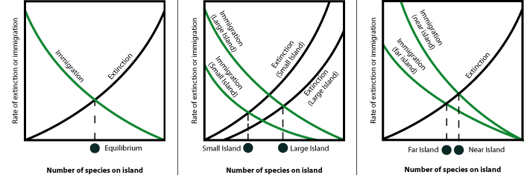
Equilibrium Theory of Island Biogeography
MacArthur and Wilson (1967)
http://www.anoleannals.org/
Notes:
To better understand extinction, we need to go back to famous theory of Island Biogeography of MacArthur and Wilson. At its core, this theory deals with species-area relationships, or the interplay between the area of a habitat and its species richness. The experiment they conducted in the 60’s dealt with islands because it is easier to simulate these relationships for species on discrete patches, such as islands. The theory suggests that the number of species in any given region is at an equilibrium determined by extinction and colonization (or immigration).

Slide 5
Equilibrium Theory of Island Biogeography
MacArthur and Wilson (1967)
http://www.anoleannals.org/
Notes:
What McArthur and Wilson did, is to select a bunch of small mangrove islands off the coast of Florida: some were small, some were large; some were close to the mainland, some were farther away. They went ahead and fumigated all islands, thus killed all the invertebrate (insect) fauna. They counted the number of species, when then waited to see who recolonizes the islands. They found that islands close to mainland were colonized quicker and accumulated species more rapidly than islands gar from the mainland. That makes sense, as only some species were able to fly long distances across water.

Slide 6
Equilibrium Theory of Island Biogeography
MacArthur and Wilson (1967)
http://www.anoleannals.org/
Widely accepted ecological theory →
applicable to how we assess extinctions based on land area
Notes:
At the same time, larger island were able to host more species, ad had lower overall extinction risk than small islands. So, if you are a small island far from mainland, you could be doomed. If you are a large island close to mainland, species are likely to persist because colonization.
This became a widely accepted theory, and despite assumptions and shortcomings, I is sill one of the strongest theories we have in ecology to this day.

Slide 7
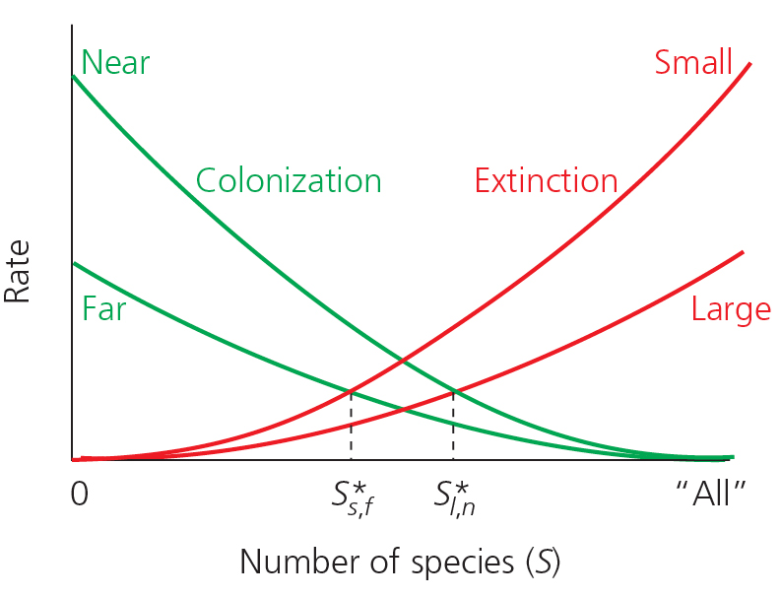
Equilibrium Theory of Island Biogeography
Island Biogeography:
Species-Area Relationship
MacArthur and Wilson (1967)
Describes the relationship between rates of colonization and extinction on islands
Patch size, distance between patches, and matrix between patches --- THEY ALL MATTER

Slide 8
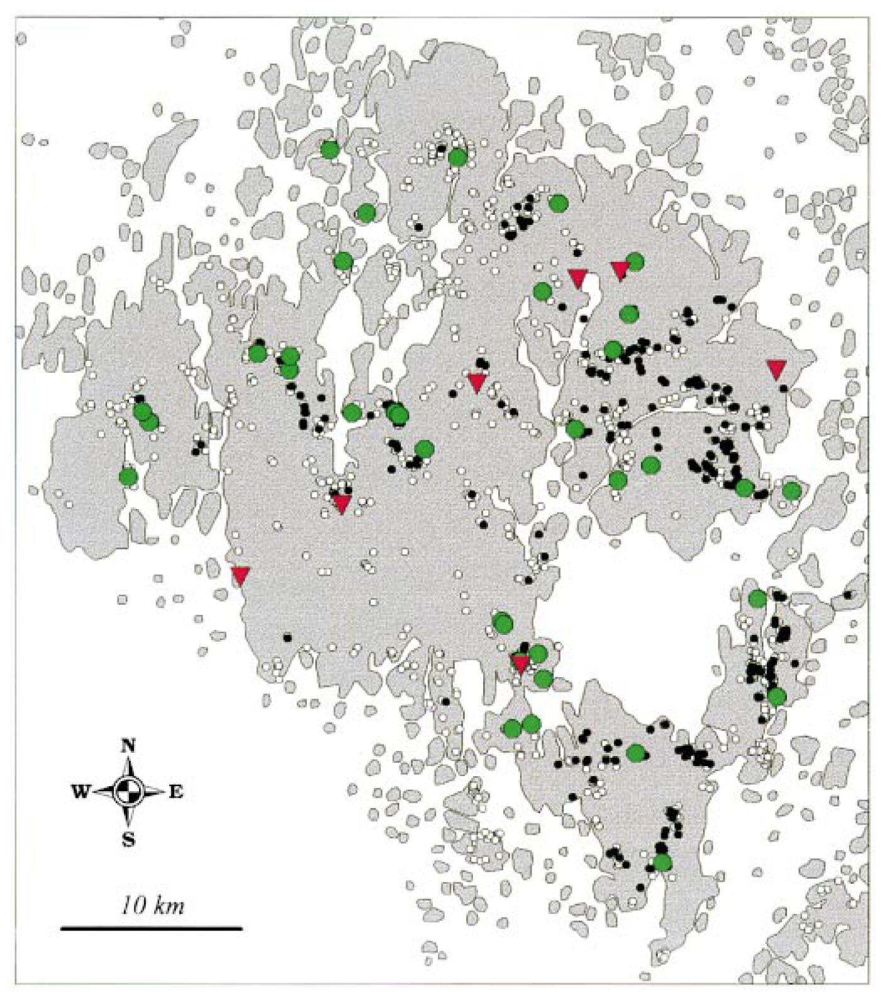
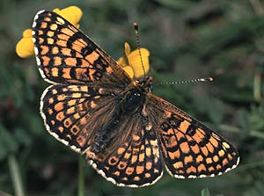
A classic metapopulation: the Glanville Fritillary
Small populations specialized on particular host plant species
High rates of local extinction and colonization – dependent on area & connectivity
Regional persistence
Ilkka Hanski & colleagues
University of Helsinki
Pops. sampled
Pops. extinct next year
All known suitable sites with larvae
Åland, Finland
All known suitable unoccupied sites
Notes:
Occupies 4000 dry meadows in an area 50 X 70 km… suitable habitat lost to farming etc. Now only 20% left of the habitat that was there 50 year ago
All known suitable meadows are shown as small circles, with meadows in which Glanville fritillary larvae were present in autumn 1995 indicated by black circles (and large symbols), and unoccupied meadows by white circles.
Of the 42 local populations sampled, the 35 that survived to autumn 1996 (green circles) are distinguished from the seven that went extinct (red triangles).

Slide 9
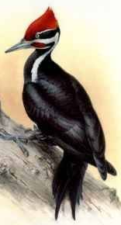
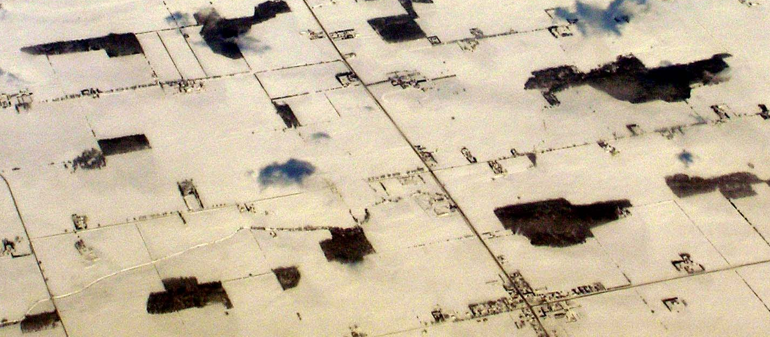
EXTINCTION and COLONIZATION
x
x
12 habitat patches, 5 are occupied
2 local extinctions, 3 patches colonized
Notes:
1. EXTINCTION RISK depends upon balance b/w LOSS of subpops due to LOCAL EXTINCTION and the gain of SUBPOPS due to COLONIZATION of VACANT HABITAT
2. EQUILIBRIUM exists where LOSSES = GAINS (but can still have turnover).
3. This EQUIBILIBRIUM depends upon RATE of DISPERSAL AMONG HABITAT PATCHES (b/c dispersal governs colonization) && PER-PATCH EXTINCTION RATE.

Slide 10
EXTINCTION and COLONIZATION
12 habitat patches, 5 are occupied
2 local extinctions, 3 patches colonized – now 6 are occupied
Notes:
1. EXTINCTION RISK depends upon balance b/w LOSS of subpops due to LOCAL EXTINCTION and the gain of SUBPOPS due to COLONIZATION of VACANT HABITAT
2. EQUILIBRIUM exists where LOSSES = GAINS (but can still have turnover).
3. This EQUIBILIBRIUM depends upon RATE of DISPERSAL AMONG HABITAT PATCHES (b/c dispersal governs colonization) && PER-PATCH EXTINCTION RATE.
** This equilibrium depends upon the RATE OF DISPERSAL AMONGST HABITAT PATCHES (because dispersal governs COLONIZATION) and the PER-PATCH EXTINCTION RATE.**
Even when EQUILIBRIUM of OCCUPANCY reached (i.e. roughly same % occupied each year), TURNOVER CAN CONTINUE – EMPTY PATCHES CONTINUALLY SHIFT FROM PLACE TO PLACE –
At risk of EXTINCTION if further HABITAT LOSS / INTERFERENCE with DISPERSAL reduces colonization rates so severely that they can’t balance extinctions…. But how much? To answer that, we need a model!

Slide 11
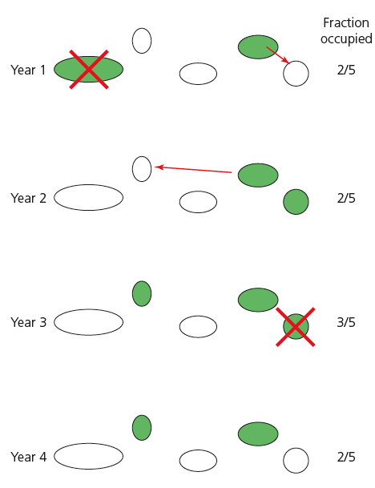
Turnover of patch occupancy over time
Notes:
** This equilibrium depends upon the RATE OF DISPERSAL AMONGST HABITAT PATCHES (because dispersal governs COLONIZATION) and the PER-PATCH EXTINCTION RATE.**
Even when EQUILIBRIUM of OCCUPANCY reached (i.e. roughly same % occupied each year), TURNOVER CAN CONTINUE – EMPTY PATCHES CONTINUALLY SHIFT FROM PLACE TO PLACE –
At risk of EXTINCTION if further HABITAT LOSS / INTERFERENCE with DISPERSAL reduces colonization rates so severely that they can’t balance extinctions…. But how much? To answer that, we need a model!

Slide 12
Formal Definitions (Hanski and Simberloff 1997)
Local Population: “Population, subpopulation, deme”
  Set of individuals that live in the same habitat patch and therefore interact with each other; most practically applied to “populations” living in such small patches that all individuals practically share a common environment
Metapopulation:
  Set of local populations within some larger area, where typically migration from one local population to at least some other patches is possible (but see non-equilibrium metapopulation where this is not needed)

Slide 13
Types of Metapopulations
Levins metapopulation
“classical metapopulation”
  A large network of similar small patches, with local dynamics occurring at a much faster time scale than metapopulation dynamics; sometimes used to describe a system in which all local populations have a high risk of extinction
Mainland-island metapopulation
“Boorman-Levitt metapopulation”
  System of habitat patches located within dispersal distance from a very large habitat patch where the local population never goes extinct (hence, M-I metapopulations never go extinct)

Slide 14
More Types of Metapopulations
Source-sink metapopulation
  System where at low density there are subpopulations with negative growth rates (in absence of dispersal) and positive growth rates
Non-equilibrium metapopulation
  System in which long-term extinction rates exceed colonization or vice-versa; an extreme case is where isolation among subpopulations is so great that dispersal (and hence recolonization) is precluded

Slide 15
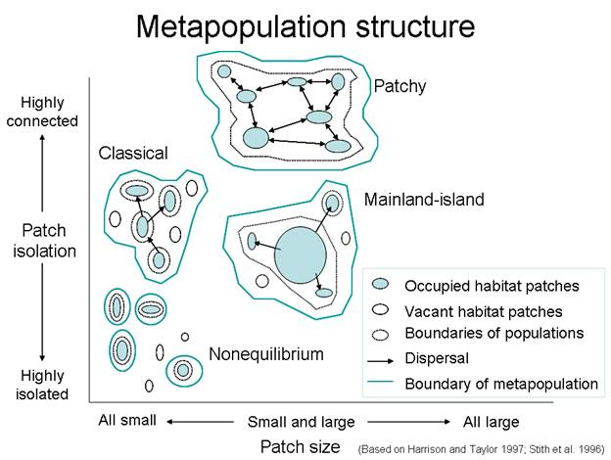

Slide 16
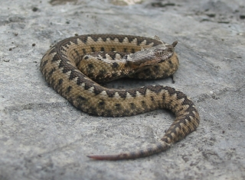
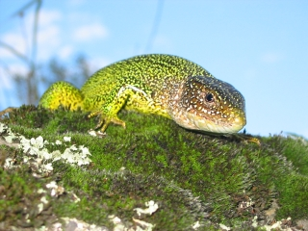
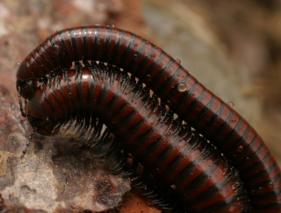
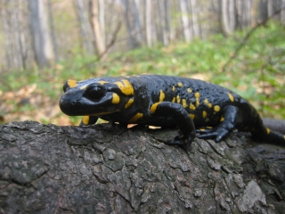
Key conservation messages
from metapopulation theory
Unoccupied but suitable habitat can be very important
Reduced dispersal success can cause a metapopulation to become extinct
A metapopulation can become extinct long before all of the habitat patches are destroyed → Critical Threshold for Habitat Destruction
Arrangement and connectivity of patches can be just as important as the absolute amount of habitat that remains
What happens locally depends on regional context

Slide 17
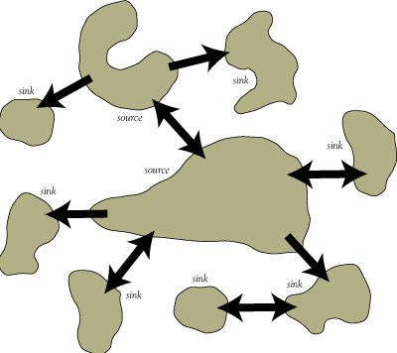
More on Sources and Sinks
Source = a patch with a positive intrinsic growth rate (r>0) that contributes more immigrants to nearby patches than it receives back from these neighboring patches. A source population should persist indefinitely, even in isolation.
Sink = a patch with a negative intrinsic growth rate (r<0). A sink population would go extinct if it were not for the constant input of immigrants from nearby source populations. Sink populations can not persist in isolation.
Are Sink populations always bad for conservation?

Slide 18
More on Sources and Sinks
Pseudo-sink = a patch with positive population growth (r>0) whose abundance is artificially augmented above its own carrying capacity by immigrants from nearby source populations. In isolation (in the absence of a nearby source population) a pseudo-sink would not go extinct but would settle down at a lower equilibrium abundance (i.e., its own carrying capacity).
Ecological trap = a patch with low quality (likely a true sink!) that attracts a disproportionate number of immigrants from nearby patches. The survival and reproductive value of an ecological trap is low, thus leading to an increased likelihood of global or regional extinction. Ecological traps occur due to maladaptive habitat selection due to mismatches between habitat quality and cues that animals use to select habitat.

